Slide 1



A brief presentation on
“Zigbee”
A tool for automation and smart control system
Presented by:
S M Nasimul Hasan
ID : IT-21026 Department of ICT
Mawlana Bhashani Science and Technology University
Presented to:
Dr. Md. Nazrul Islam
Associate Professor Department of ICT
Mawlana Bhashani Science and Technology University

Slide 2
Outlines
Introduction
Objectives
Features and Technology
Security
Conclusion

Slide 3
Introduction
Zigbee is an open, global wireless technology standard that is specifically designed for the Internet of Things (IoT) to enable communication between devices that require low cost, low power, and low data rates.
It is the technology that makes smart homes a reality, the communication easier, and gives a smart control over the house and communication system.

Slide 4


Objectives
Smart Control
Low power, low cost
Communication at distance
Interoperability

Slide 5
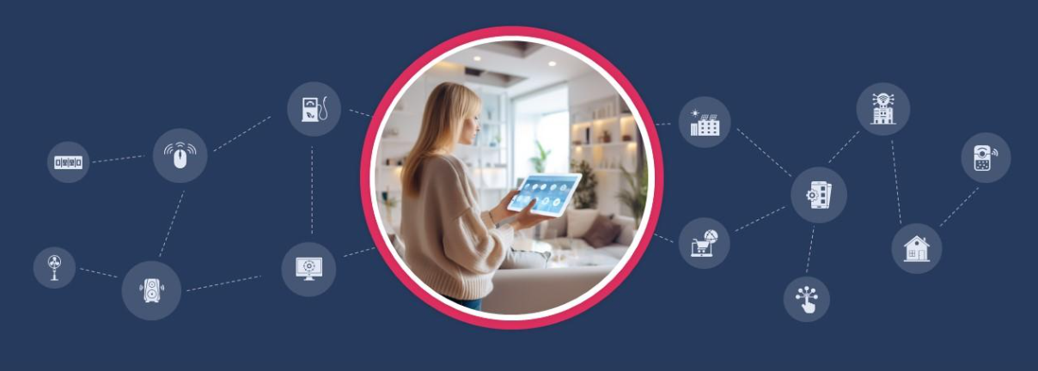


Features
Feature are actually the solutions to the problems we
face while doing something.
So, what problems does a person face when he is out of his house and office? He can’t see what is happening there. Or, What are the problems we normally have when we want a complete smart home. Zigbee solves those problems for us.
Mesh-Network gives interoperability
Communication and control at a distance more than radio distance
Minimal usage
Affordable implementation

Slide 6
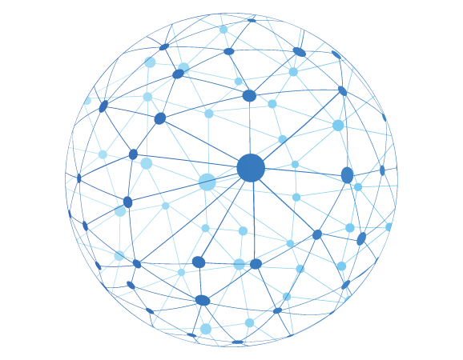
Features
Mesh-Network Facility
Mesh networks make call the devices connected to the ZigBee
in a single network. Thus, they are always ready to be accessed
from far distance and work. And as they are all connected with
each other they communicate with each other and process ins-
-tructions together for a certain job. This give the network high
interoperability.

Slide 7
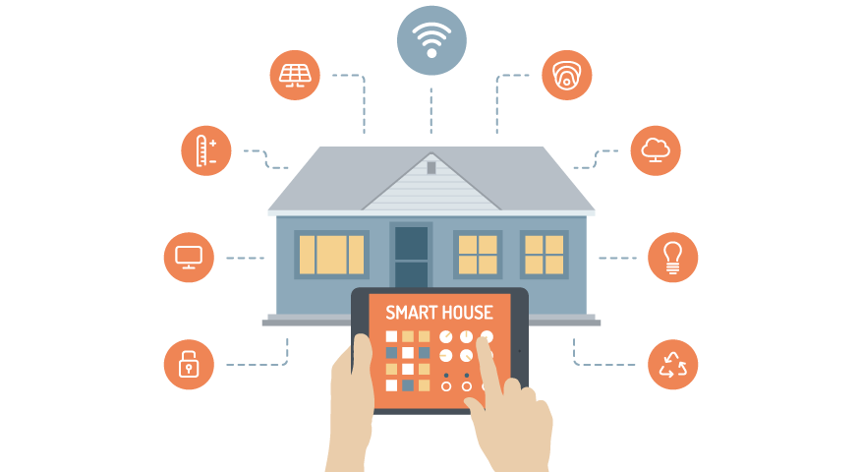
Features
Communication at Distance
Foundation Protocol: Zigbee is built upon the
IEEE 802.15.4 standard, which defines the physical
radio and media access control layers (the lowest layers)
Device Roles: The network consists of three main roles:
Coordinator (ZC): Forms and manages the entire network (the central brain).
Router (ZR): Relays data for other devices (typically mains-powered).
End Device (ZED): Performs a simple function and conserves battery power by sleeping (e.g., a sensor)

Slide 8

Features
Minimal Usage
Low Data Rate: ZigBee is optimized for transmitting small, intermittent bursts of data (like sensor readings or status updates) at a low rate (up to 250 kbps), rather than continuous, high-bandwidth streaming. This reduces the time the radio needs to be active
Sleep Mode for End Devices: Devices like sensors (known as Reduced Function Devices or ZEDs) can spend most of their time in a deep sleep mode, drawing minimal power. They only wake up for a very short duration (milliseconds) to transmit or receive data from a parent node (Coordinator or Router) and then immediately go back to sleep, allowing batteries to last for months or even years.
Simple Protocol Stack: The protocol is intentionally simple, requiring less processing power and memory, further contributing to lower energy use and reduced manufacturing cost.

Slide 9

Features
Affordable Implementation
Simple Hardware and Chipsets: ZigBee is optimized for low data rates (up to 250 kbps), which means it requires smaller, less powerful, and consequently less expensive chips and hardware components compared to high-bandwidth standards like Wi-Fi.
Low Power Consumption: Devices are designed to operate on very low power, often entering a sleep mode for long periods. This allows them to run for years on small, inexpensive batteries.
Open Standard/No Royalties: As an open standard, manufacturers do not have to pay licensing fees or royalties for the ZigBee protocol (IEEE 802.15.4) itself, contributing to the competitive pricing of ZigBee-enabled devices.

Slide 10

Security
The security measure of ZigBee is much bigger and complex, though we can
Classify the strong security features as follows:
AES-128 Encryption: A 128-bit key shared by all devices on the network. It's used for network-wide, hop-by-hop encryption of most packets (at the Network Layer, NWK).
Message Integrity Code (MIC): Used for authentication and integrity, ensuring the data has not been altered in transit and came from a device possessing the correct key.
Frame Counters: A 32-bit counter included in the security header to protect against replay attacks, where an attacker captures and re-sends a valid message.

Slide 11



Limitations
Limited Range
2
Interference
1
3
Low Data Rates

Slide 12

Conclusion
Distant Communication
Can connect devices from far and relentlessly using its mesh network structure
1

Slide 13

Conclusion
Affordability
Uses low power, lower hardware system,
lower data rates and open-source tech.
Distant Communication
Can connect devices from far and relentlessly using its mesh network structure
2
1

Slide 14

Conclusion
Affordability
Uses low power, lower hardware system,
lower data rates and open-source tech.
Distant Communication
Security
Can connect devices from far and relentlessly using its mesh network structure
Uses end-to-end encryption at each
level
2
1
3

Slide 15

Thanks for Your Attention

